Slide 1
Chemistry 3A
Introductory General Chemistry
Properties of Liquid and Solid Phases; Surface Tension, Viscosity, Capillary Action; Crystalline Solids; Energy, Heat, Temperature; Heat Capacity; Phases: Melting, Freezing, Sublimation, Boiling, Evaporation, Condensation
S. M. Halloran

Slide 2
Properties of Liquids and Solids as Phases
Surface Tension, Viscosity, Capillary Action
Crystalline Solids
Energy, Heat, Temperature
Heat Capacity
Describing Transitions of Phases: Melting, Freezing, Sublimation, Boiling, Evaporation, Condensation

Slide 3
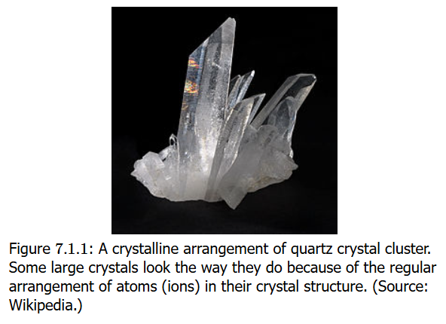
Liquid, Solids, Gases: Properties
Liquids and solids: condensed phases because particles in contact
Solids
particles in fixed positions
Definite shape
Definite volume
Usually hard (crystals/rock),
but sometimes soft (fat/wax)
Ionic solids quite brittle:
3-D array of positive & negative ions (crystal)
Large molecule solids (glass) cannot organize particles as crystals → amorphous solids

Slide 4
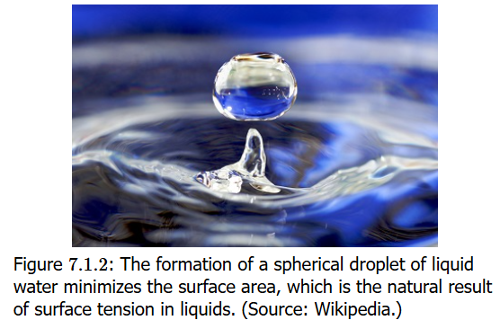
Liquid, Solids, Gases: Properties
Liquids
particles have enough
(thermal) energy to overcome
intermolecular interactions,
but particles still move while
contacting each other
Definite volume: cannot be readily compressed
but no definite shape: has a variable shape

Slide 5
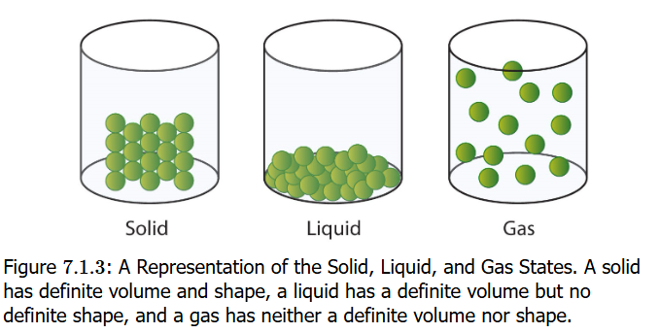
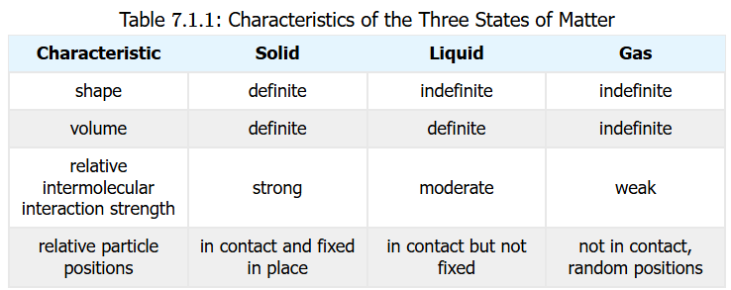
Liquid, Solids, Gases: Properties
Gases
Like liquids, particles have
enough (thermal) energy
to overcome intermolecular
interactions & separate from
each other, moving randomly in space
NO definite shape or volume
Volume increases by a 1000 times or more

Slide 6
Water
The liquid of life,
the “universal solvent”
No definite shape
No definite volume
The density of ice is lower
than for water
Water also absorbs and
releases energy (as heat) without large changes in
temperature, unlike solid metals like steel, made
up of element iron (Fe)
Substance | Melting Point | Boiling Point
water | 0°C | 100°C
ammonia | –78°C | –33°C
Methane | –182°C | –162°C

Slide 7










Slide 8
Some Terms, Definitions
In the topics on surface tension, viscosity and capillary action to be discussed, certain terms should be understood
Cohesion describes the force or attraction of molecules of the same kind/identity to each other. This describes how H₂O (water) molecules will create a water droplet. Verb infinitive: to cohere
Adhesion describes the force or attraction of molecules of different kind/identity to each other, such as when H₂O (water) sticks to sides of glass. Verb infinitive: to adhere

Slide 9
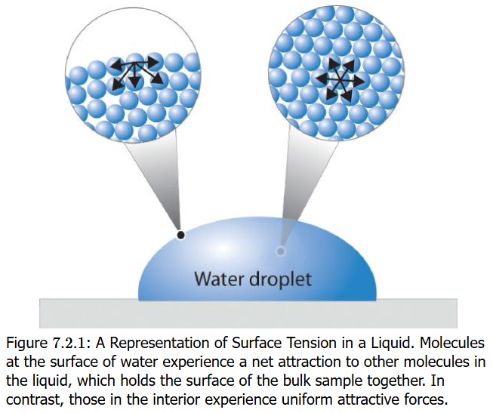
Surface Tension
Surface tension is the property of a liquid's surface to resist an external force by minimizing its surface area, caused by the cohesive (intermolecular) forces between liquid molecules that are imbalanced at the surface
Water has a high surface tension: it explains why water forms droplets form on a waxy surface (leaves, car bodies) rather than spread themselves thin
Minimizing surface area: explains
why water forms spherical droplets
because sphere is smallest
possible surface area for any
volume

Slide 10
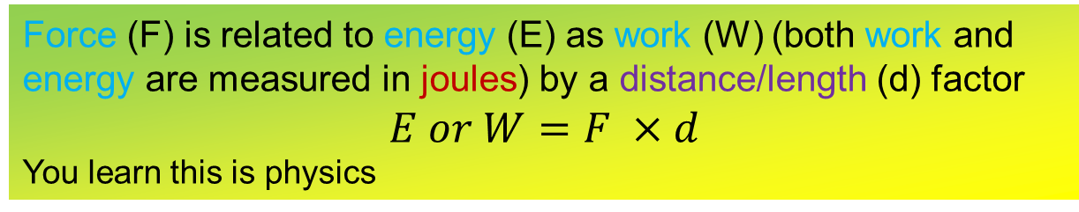
Surface Tension UNITS
Surface tension is a quantity with units of joules (J) per square meter (m²): J / m² OR
dyne (dyn) per centimeter (cm): dyn/cm
The joule is measure of energy while the dyne and the newton [N] (1 N = 100,000 dyn) is a measure of force
The higher (stronger) the intermolecular forces, the higher the surface tension
Water has very high intermolecular force (because of hydrogen bonding [later] while organic molecules have lower intermolecular force/surface tension
Force (F) is related to energy (E) as work (W) (both work and energy are measured in joules) by a distance/length (d) factor
$$E or W=F ×d$$
You learn this is physics

Slide 11
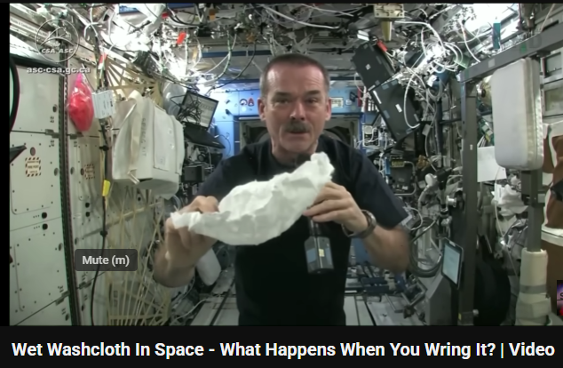
Surface Tension Fun
Surface tension at zero gravity: check it out
https://www.youtube.com/watch?v=lMtXfwk7PXg

Slide 12
Capillary Action
Capillary action is the movement of a liquid through or along a solid material, even against gravity, driven by the forces of cohesion (a liquid's attraction to itself), adhesion (a liquid's attraction to a solid surface), and surface tension.
When the adhesive forces between the liquid and the solid are stronger than the cohesive forces within the liquid, the liquid will "climb" the solid, which is seen in examples like a paper towel absorbing a spill or water traveling up a plant's xylem

Slide 13
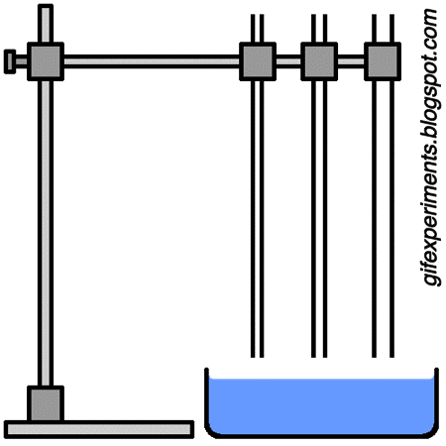
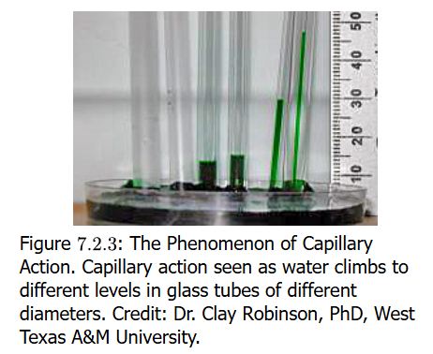
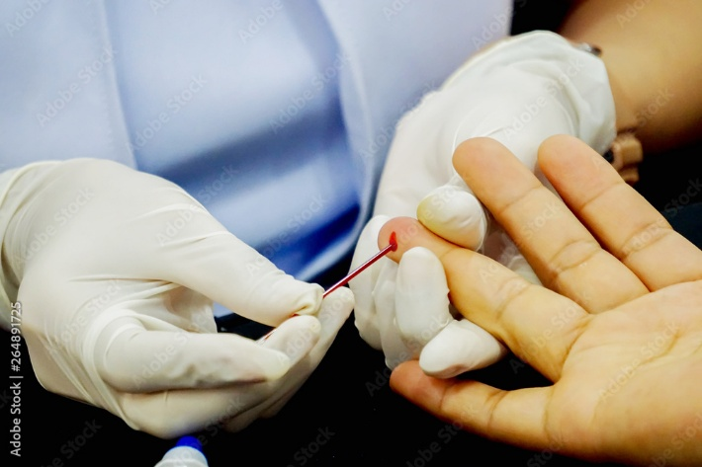
Capillary Action
It is called “capillary action” because a capillary tube, which is a very small diameter tube, when one of its open ends is placed in a liquid (water, even
blood), will draw a small sample volume of that liquid into the tube as a result of adhesion to the glass and cohesion with other liquid molecules

Slide 14
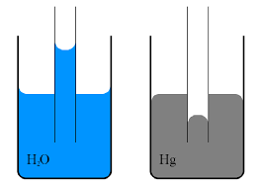
Water vs Mercury in Capillary Action
Water will have strong adhesion to glass. Glass is composed of silanol (–Si–OH) groups (note the H-bonding hydroxyls), which interact with water’s natural H-bonding hydroxyls
(H–O–H), creating a force which draws a volume of water above the level of water in a container although. The meniscus in the capillary is concave
Mercury however has no strong bonding interaction to glass wall silanol groups, so adhesion is nil.
However, the cohesive forces in
mercury are much stronger and they
pull any mercury in the capillary
down below the level of the mercury
in the container. The meniscus in the
capillary is convex

Slide 15
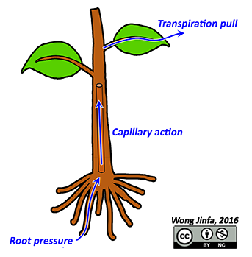
Biological Capillary Action
Capillary action is also observed in plant life
Fluids and nutrients are transported up stems and tree trunks as water adheres easily in the capillary-like structure of the plant’s xylem

Slide 16
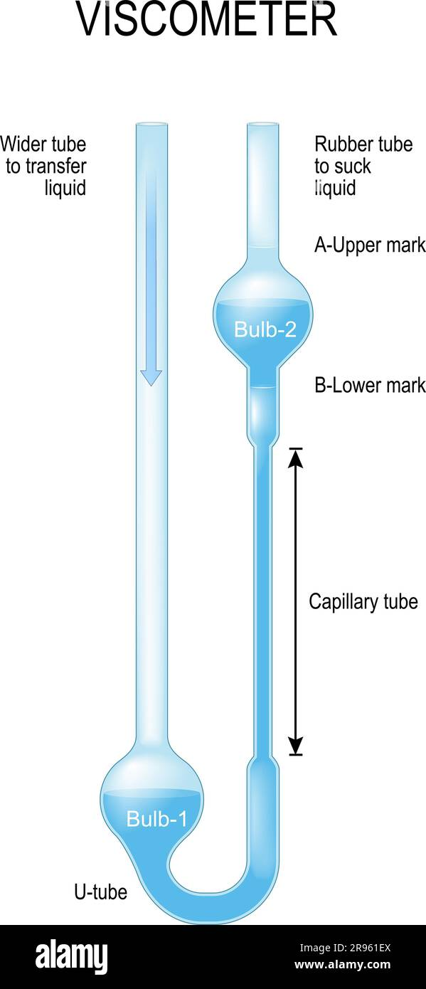
Viscosity
Viscosity (symbol Greek letter eta η)
is the resistance of a fluid to flow,
often described as its "thickness" or
internal friction
A viscometer is a special glass device
that measures time it takes for test
liquid to flow through narrow vertical
tubing
Units of viscosity: poise (1 poise = 1 mPa s)
If a liquid has strong intermolecular forces,
the molecules will not move past each other
but slowly. Adding an –OH group to ethanol
(CH₃CH₂OH) to make ethylene glycol
(HOCH₂CH₂OH)

Slide 17
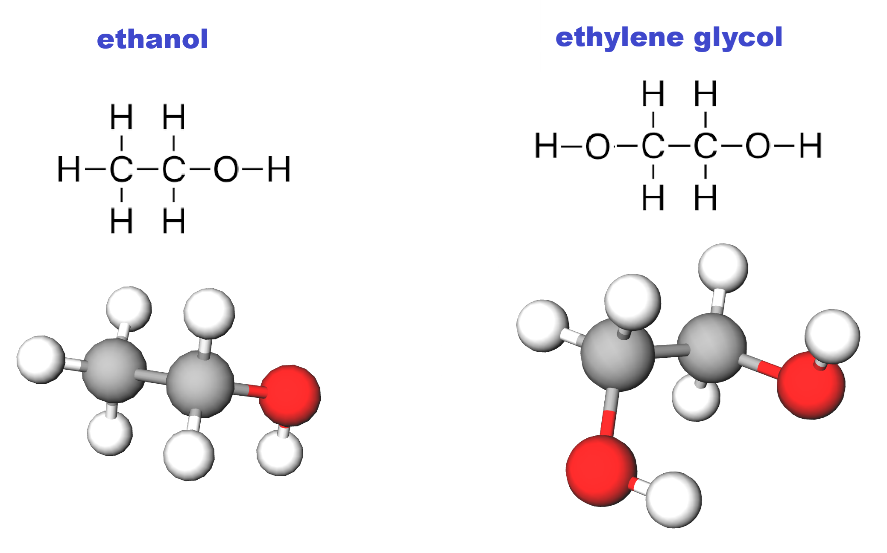
Viscosity
If a liquid has strong intermolecular forces, the molecules will not move past each other but slowly. Adding an –OH group to ethanol (CH₃CH₂OH) to make ethylene glycol (HOCH₂CH₂OH) increases viscosity by 15 times, as it creates a second interconnecting bridge-like point through hydrogen bonding

Slide 18
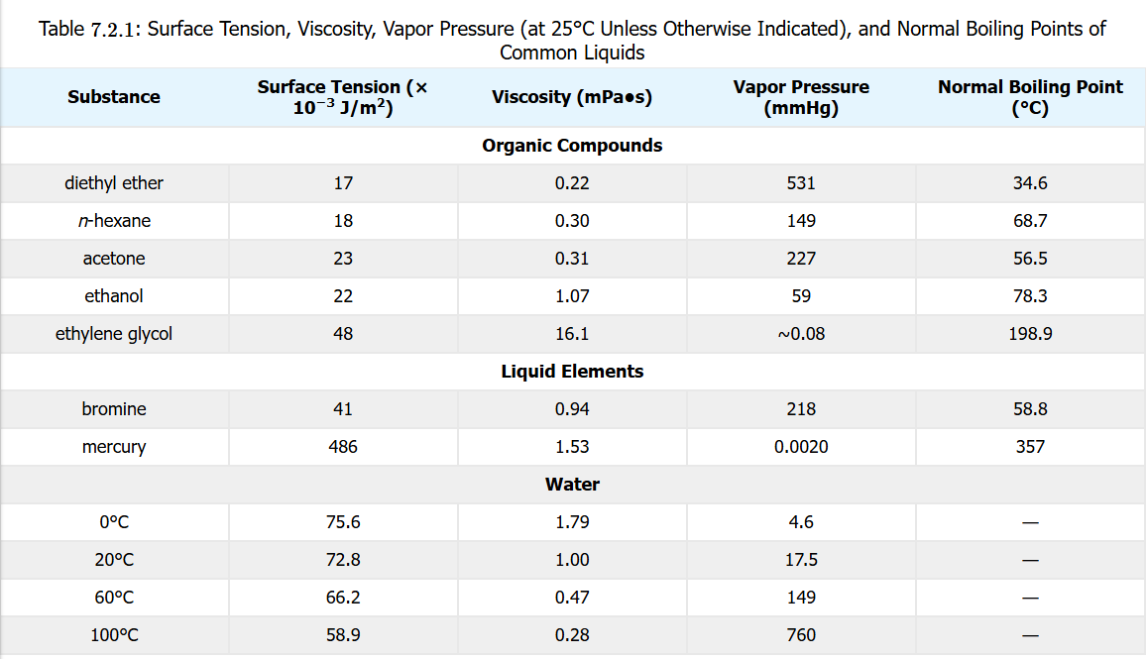
Liquid Properties in Review
The table reveals patterns (correlations) in surface tension and stronger intermolecular forces
Although mercury (Hg) does not show the strong intermolecular forces usually in hydrogen bonding, it does have a high surface tension indicative of metallic bonding

Slide 19
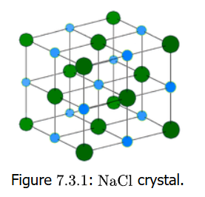
Crystalline Solid Classes
There are four classes of crystalline solids
Ionic
  Sodium chloride (NaCl) is the
  classic monatomic type,
  but polyatomic types also exist.
  The formula unit in the crystal
  shows alternating cations & anion
  Typically Group 1 & 2 cations combine with
  Group 16 & 17 anions
  Crystals hard, brittle, high melting points
  They are not electrically conductive as solids, but in aqueous solution and molten (liquid) state, they are conductive

Slide 20
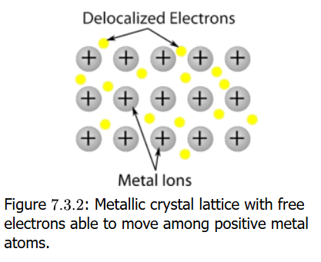
Crystalline Solid Classes
Metallic
  A metallic crystal is actually metal
  atoms as cations (positively
  charged atoms) whose electrons
  exist as a “lake” or “sea” of
  valence electrons not tethered or
  bound to the metal atoms
  (delocalized electrons). This makes these solid metals excellent electrical conductors as electrons move freely
  Melting points are HIGHER for metals when:
    More valence electrons -- Al (3) > Mg (2) > Na (1)
    Higher ionic charge pulls on delocalized electrons – Al³⁺ > Mg²⁺ > Na⁺ (direct consequence of previous point)
    Smaller ionic radius – stronger electrostatic attraction between cation and the delocalized mobile electrons

Slide 21
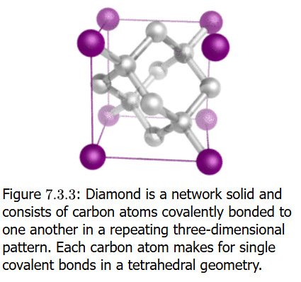
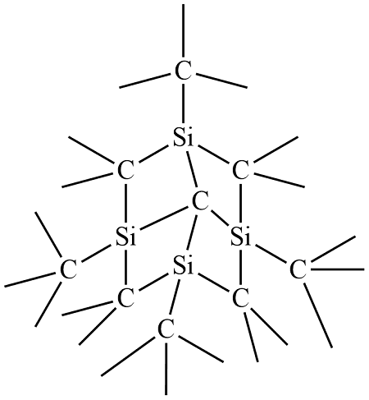
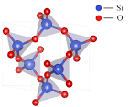
Crystalline Solid Classes
Covalent Network
  All atoms in the crystal form a very
  strong covalent bond to neighboring
  atoms usually in an orderly lattice
  Classic example is diamond,
  composed of carbons bonded in
  tetrahedral shape in a large network
  Other examples are pure silicon (Si),
  quartz (SiO₂), carborundum (SiC),
  borazon (BN)
  The atoms are not ions (ionic),
  so they are NOT electrically
  conductive

Slide 22
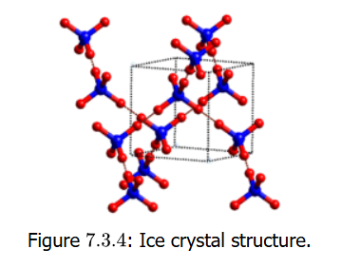
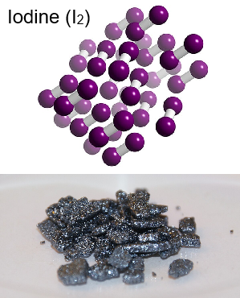
Crystalline Solid Classes
Molecular
  Previous solids had ions, metal
  cations, and atoms in networks
  These solids are molecules connected
  (bonded) by INTERMOLECULAR
  forces: hydrogen bonding, dipole-dipole,
  dispersion forces in nonpolar crystals
  Examples: H₂O solid (ice), iodine (I₂), CO₂ solid (dry ice)
  Physical properties like melting &
  boiling points are lower. Since they are not
  ionic or having mobile electrons, they are
  poor electrical conductors

Slide 23
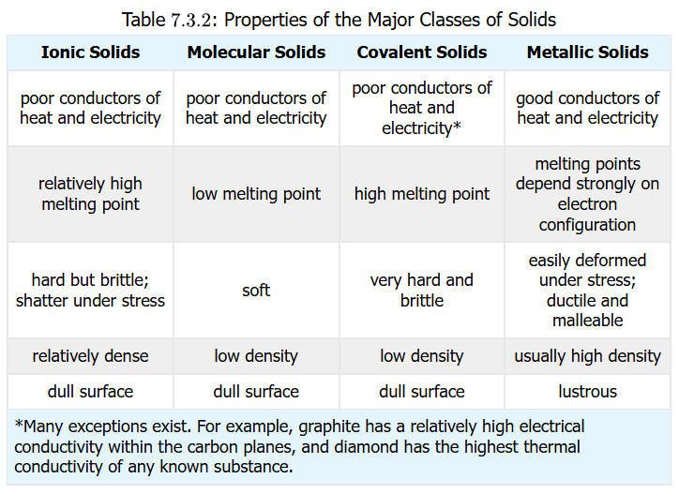
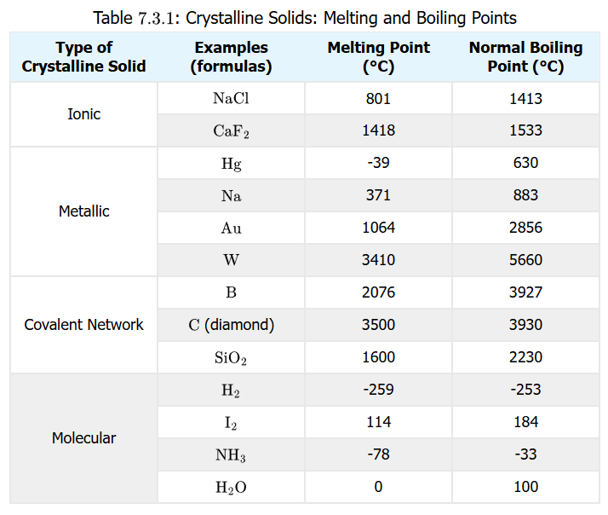
Review: Crystalline Solid Classes
Problem solving:
Classify Ge, RbI, C₆(CH₃)₆, Zn, CO₂, BaBr₂, GaAs, AgZn as ionic, molecular, covalent network, metallic and order them by melting points
(exercises in your book)

Slide 24
Universe: System & Surroundings
Forms of Energy: kinetic, potential
Transferred as heat or work
Always conserved (not created or destroyed) in the universe
The universe
  The system: what we are looking at (observing) or studying in experiment
  The surroundings: everything outside or not part of the system
  Energy exchange/transfer occurs between system and surroundings: energy lost by system is gained by surroundings and vice-versa

Slide 25
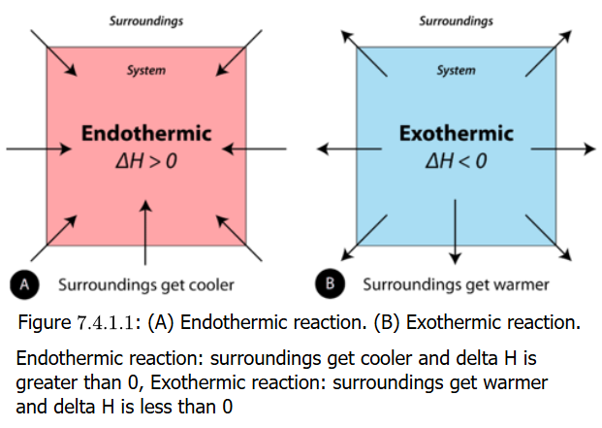
Endothermic / Exothermic Reactions
Endothermic reactions are when heat/energy comes or is absorbed from surrounding into system
(endo- “within”, “inside”, “taking in”) (-thermic is heat or energy)
Exothermic reactions are when heat/energy is released from system into surroundings
  (exo- “out”, “outward”) (-thermic is heat or energy)
When phase changes occur,
energy changes also happen
Dry ice vaporization means CO₂
molecules absorbs energy
Water becoming ice means H₂O
molecules release energy to
surroundings

Slide 26
Endothermic or Exothermic?
Water boiling?
  endothermic
Gasoline burning?
  exothermic
Ice forming on pond?
  exothermic
Water vapor condensing?
  exothermic
Gold melting?
  endothermic
The point is to understand if energy is going into the system (from the surroundings) or being removed/released from the system (into the surroundings)

Slide 27
Book Confusion (not for exam)
In talking about endo- and exothermic processes in reaction with energy transfer between surroundings and system, your book uses the symbol q and ΔH.
The proper symbol for explaining energy in this context is q, which is usually energy as heat
The symbol H is for enthalpy, which is actually the sum of the internal energy (E) (as heat) of a system AND the work energy related to changes in pressure and volume (PV). Thus H = E + PV, and ΔH = ΔE + Δ (PV). When pressure is constant, then ΔH = ΔE because
Δ (PV) = 0. This point is beyond
the scope of this course, but it is
essential to be detailed here.

Slide 28
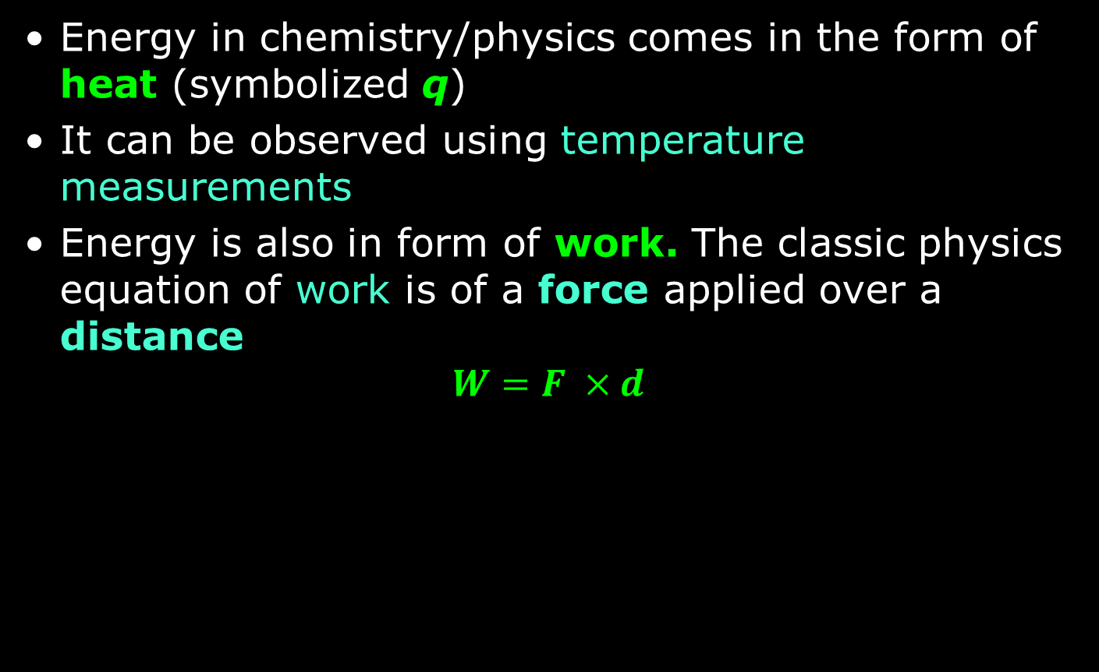
Energy: Heat & Work
Energy in chemistry/physics comes in the form of heat (symbolized q)
It can be observed using temperature measurements
Energy is also in form of work. The classic physics equation of work is of a force applied over a distance
$$W=F ×d$$

Slide 29
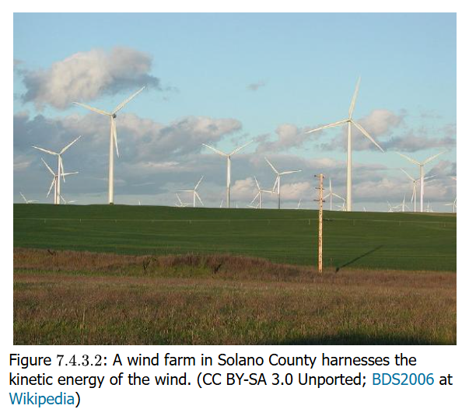
Energy: Kinetic and Potential
Kinetic energy is the energy
of motion. It's the energy
that an object possesses due
to its movement. The more
massive an object is and
the faster it moves, the more
kinetic energy it has
Potential energy is stored energy 🔋. It's the energy an object has due to its position or composition, waiting to be released or converted into another form of energy, like kinetic energy

Slide 30
Energy: Chemical Potential
Chemical Potential Energy is the stored potential energy in atoms, molecules, and the chemical bonds between them
This includes the positions between particles of matter (atoms, molecules)
It also includes the composition of the substance (compound) which affects why atoms and molecules are positioned with respect to each other

Slide 31
Measuring Energy
Energy is a quantity, so it has a number with units
Units are the calorie (cal) and the joule (J)
Definition of calorie: the amount of energy (heat) needed to raise 1 gram H₂O (water) by 1°C
Capital “C” calorie: the calories in nutrition food are a different measure:
1 Calorie = 1 kilocalorie = 1000 calories
To get joules, use 4.184 J = 1 cal as conversion factor!

Slide 32
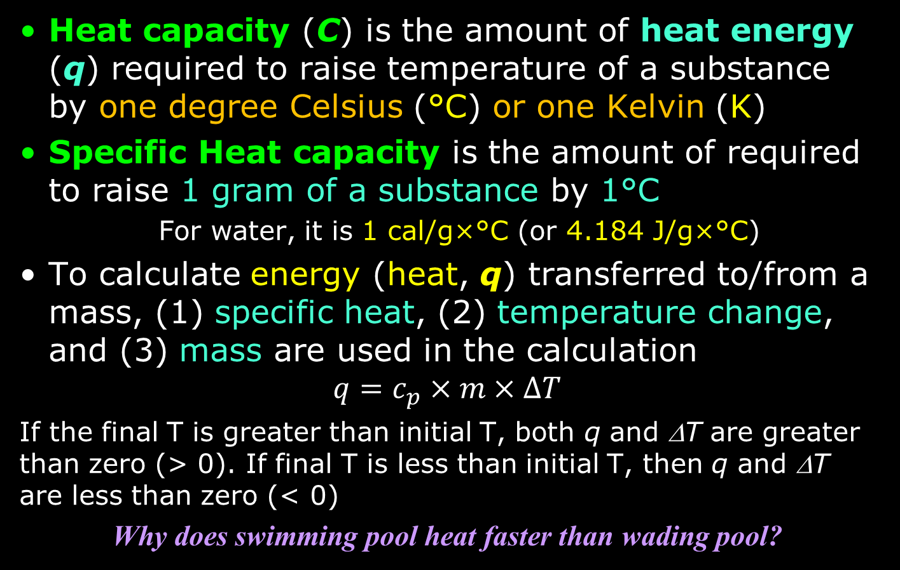
Heat Capacity
Heat capacity (C) is the amount of heat energy (q) required to raise temperature of a substance by one degree Celsius (°C) or one Kelvin (K)
Specific Heat capacity is the amount of required to raise 1 gram of a substance by 1°C
  For water, it is 1 cal/g×°C (or 4.184 J/g×°C)
To calculate energy (heat, q) transferred to/from a mass, (1) specific heat, (2) temperature change, and (3) mass are used in the calculation
$$q=c_{p}×m×ΔT$$
If the final T is greater than initial T, both q and ΔT are greater than zero (> 0). If final T is less than initial T, then q and ΔT are less than zero (< 0)
Why does swimming pool heat faster than wading pool?

Slide 33
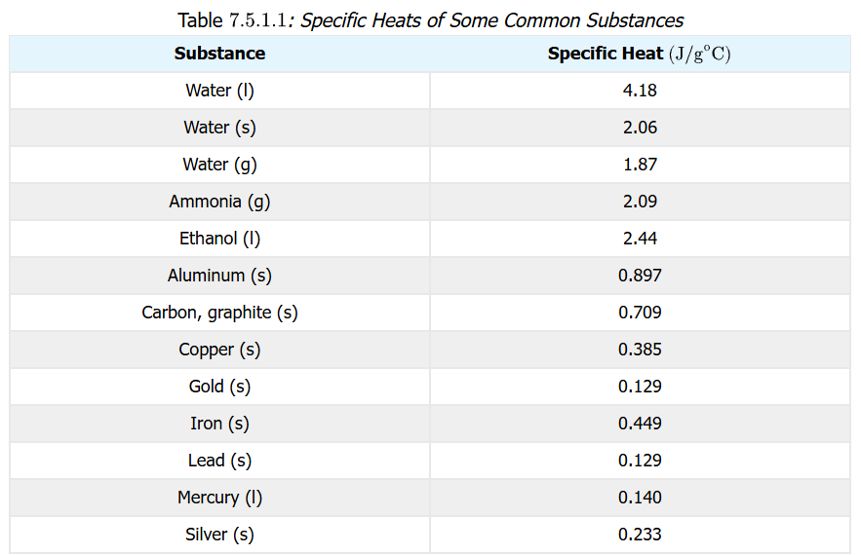
Specific Heat
The specific heat is a property of a substance or compound. NOTE THE UNITS: energy per amount of mass per temperature [as a change]
Substances with higher specific heat capacities resist changes in temperature than do those with lower specific heat
capacities!
You don’t have to
memorize values in these
tables: they are provided
for you as any reference
Be able to use your
knowledge of algebra to
make the calculation!

Slide 34

Calculations
A 15.0 g piece of cadmium (Cd) metal absorbs of 134 J heat while rising from 24.0°C to 62.7°C. Calculate the specific heat of cadmium
Needed: $q=c_{p}×m×ΔT$
Solving for c_{p}? $c_{p}= \frac{q}{m×ΔT}$ this is algebra
$$c_{p}= \frac{134 J}{15.0 g×(62.7°C −24.0°C)}=0.231\frac{J}{g °C}$$
Note we had 3 significant digits
What quantity of heat is transferred when a 150.0 g block of iron metal is heated from 25.0°C to 73.3°C? What is the direction of heat flow?
Needed: $q=c_{p}×m×ΔT$
Solving for q? Need c_{p} for iron from table: $c_{p}=0.108\frac{cal}{g °C}$
$$q=150.0 g×\frac{0.108 cal}{g °C}×\left(73.3°C −25.0°C\right)=782 cal$$
The heat flows into the metal since temperature is increasing

Slide 35
Thoughts
Explain what happens when heat flows into or out of a substance at its melting point or boiling point
  The energy goes into changing the phase, not the temperature
How does the amount of heat required for a phase change relate to the mass of the substance?
  The amount of heat is a constant per gram of substance

Slide 36
Phase Transitions
The table shows the phase transitions of matter and the (name of) the process associated with the transition
Any temperature, like melting and boiling points, known for a substance/compound with a phase transition is for the pure substance
These processes are isothermal: that means the temperature does not change while energy (heat) is being added or released from the substance!
Process | Phase Transition
melting | solid → liquid
freezing/solidification | liquid → solid
boiling/vaporization/evaporation | liquid → gas
condensation | gas → liquid
sublimation | solid → gas
deposition/desublimation | gas → solid

Slide 37
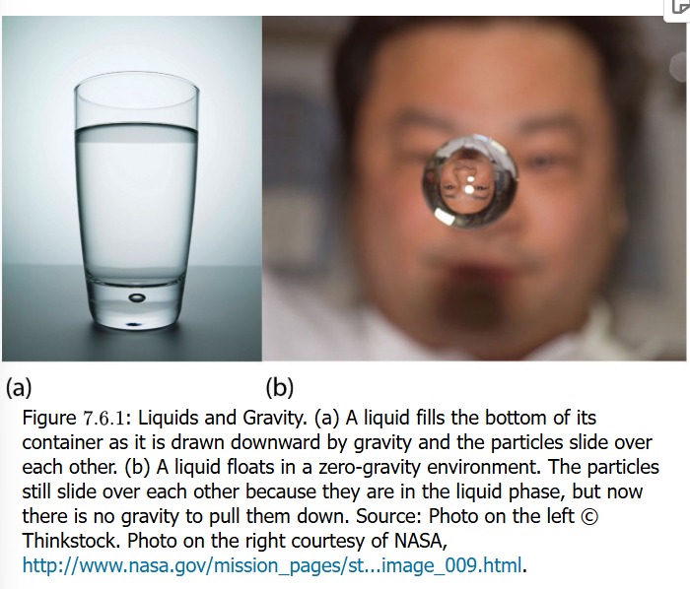
Curiosities of Phases
A liquid is observed as a fills a container. It exists at its temperature with the substance/compound molecules or atoms brought together by intermolecular forces
The liquid fills a container because of gravity (another type of force)
But in a zero-gravity
environment, it still
retains its phase as a
liquid because of those
intermolecular forces
based on other physical
properties

Slide 38
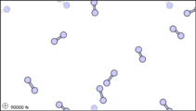
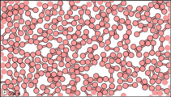
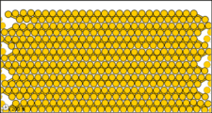
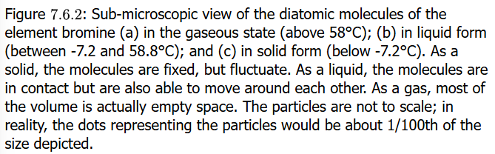
Phase Transitions
Melting, freezing, boiling or
evaporation, and other phase
transitions occur on a visible-
to-the-eye (macroscopic) level
But at the sub-microscopic
level, it is important to
note the interatomic/molecular
forces that maintain a solid,
liquid, or gaseous state

Slide 39
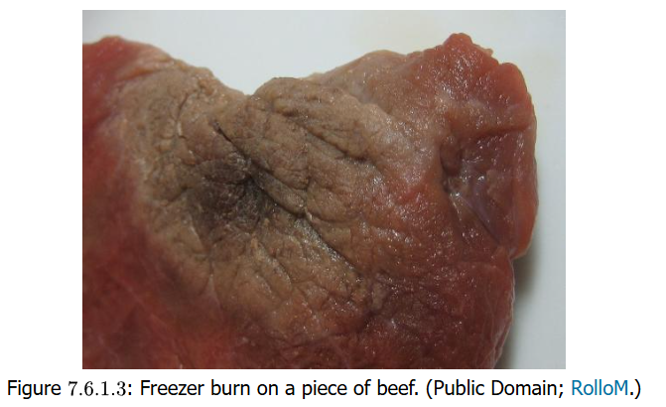
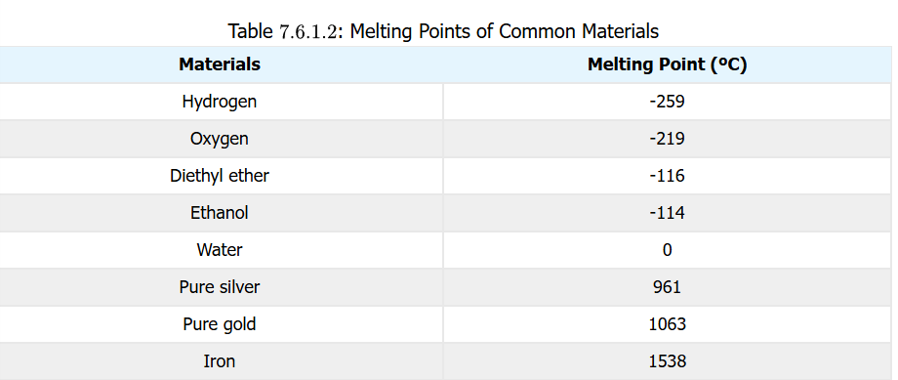
Melting/Freezing/Sublimation
Melting is an isothermal process: it occurs without any change in temperature while energy is added to cause the phase change
Freezing is opposite of melting as to phase, but it too is isothermal
Thermodynamic Symbol | Meaning
ΔH_{vap} = heat of vaporization | Energy to cause liquid → gas
ΔH_{fus} = heat of fusion | Energy to cause solid → liquid
ΔH_{sub} = heat of sublimation | Energy to cause solid → gas
Note that ΔH_{sub} =ΔH_{fus} + ΔH_{vap}

Slide 40
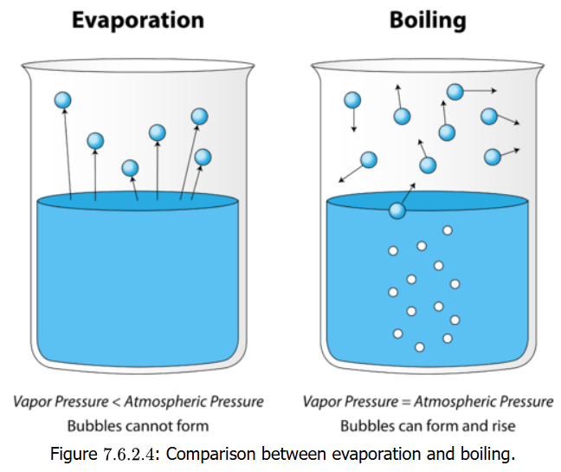
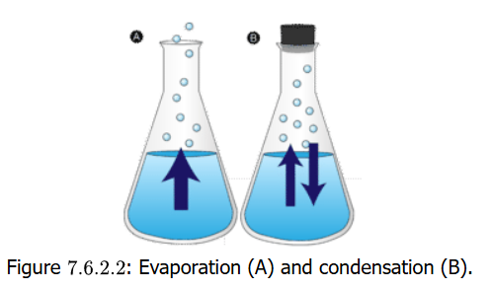
Boiling/Evaporation/Condensation
Terminology
Boiling: liquid to gas at boiling point (isothermal)
Evaporation: liquid→gas BELOW boiling point
Vaporization: liquid form of substance becomes gaseous: combines boiling and evaporation terms
Condensation: gas→liquid process and is opposite of vaporization

Slide 41
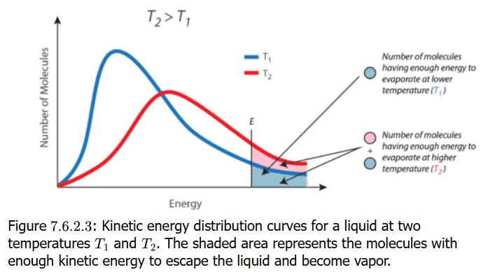
Evaporation Statistics
A liquid at two temperatures T₁ and T₂, both below boiling points of the liquid, but T₂ > T₁
Plot of # molecules versus energy is done for T₁ and T₂
The higher temperature T₂ sees faster evaporation because there is an energy point E at which an individual molecule can break free to go from liquid to gas phase, even though not at boiling point

Slide 42
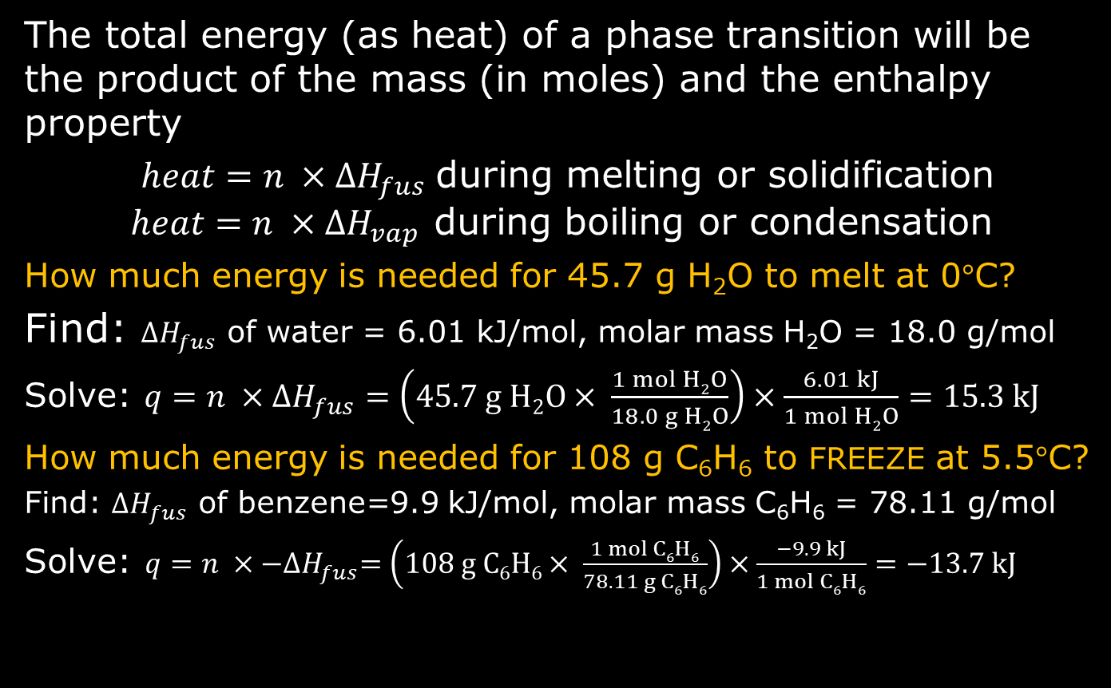
Phase Change Energy Calculations
The total energy (as heat) of a phase transition will be the product of the mass (in moles) and the enthalpy property
$heat=n ×{ΔH}_{fus}$during melting or solidification
$heat=n ×{ΔH}_{vap}$ during boiling or condensation
How much energy is needed for 45.7 g H₂O to melt at 0°C?
Find: ${ΔH}_{fus}$ of water = 6.01 kJ/mol, molar mass H₂O = 18.0 g/mol
Solve: $q=n ×{ΔH}_{fus}=\left(45.7 g H2O× \frac{1 mol H2O}{18.0 g H2O}\right)×\frac{6.01 kJ}{1 mol H2O}=15.3 kJ$
How much energy is needed for 108 g C₆H₆ to FREEZE at 5.5°C?
Find: ${ΔH}_{fus}$ of benzene=9.9 kJ/mol, molar mass C₆H₆ = 78.11 g/mol
Solve: $q=n ×{−ΔH}_{fus}=\left(108 g C6H6× \frac{1 mol C6H6}{78.11 g C6H6}\right)×\frac{−9.9 kJ}{1 mol C6H6}=−13.7 kJ$

Slide 43
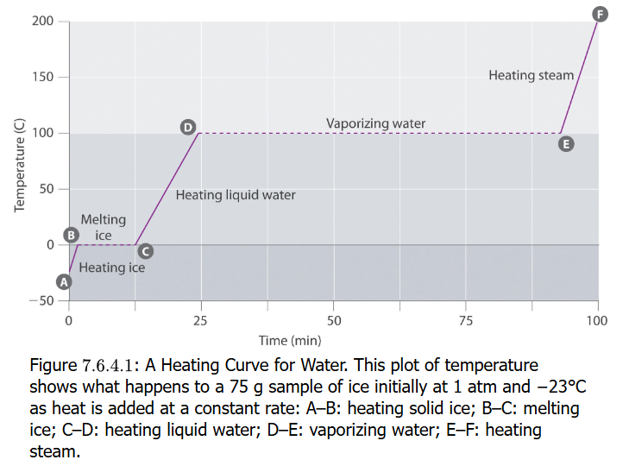
Heating Curves
A heating curve (H₂O is shown) is a plot of Temperature (°C) versus Time
Time is really a measure of Energy Input At A Constant Rate (joules per unit time)
The curve shows how the solid, liquid and gas phases absorb energy as
measured by
temperature changes
AND
it shows energy absorbed
during phase changes at
constant temperature

Slide 44
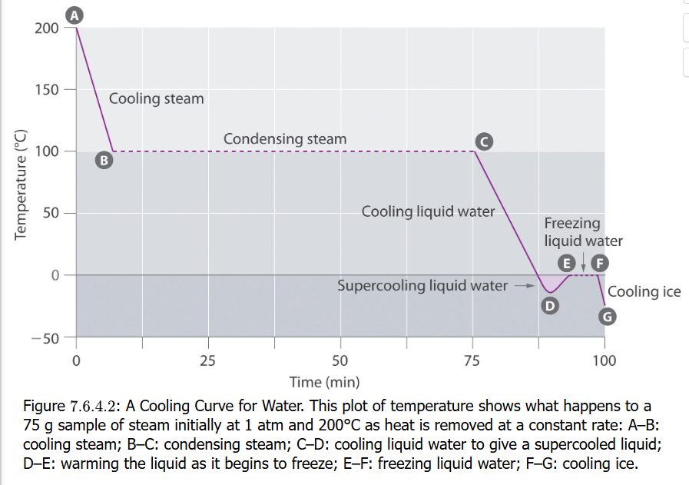
Cooling Curves
A cooling curve (H₂O is shown) is ALSO a plot of Temperature (°C) versus Time
Time is really a measure of Energy Release At A Constant Rate (joules per unit time)
The curve shows how the gas (steam), liquid and gas phases release energy
as measured by
temperature
changes
AND
it shows energy
released during
phase changes at
constant temperature

Slide 45
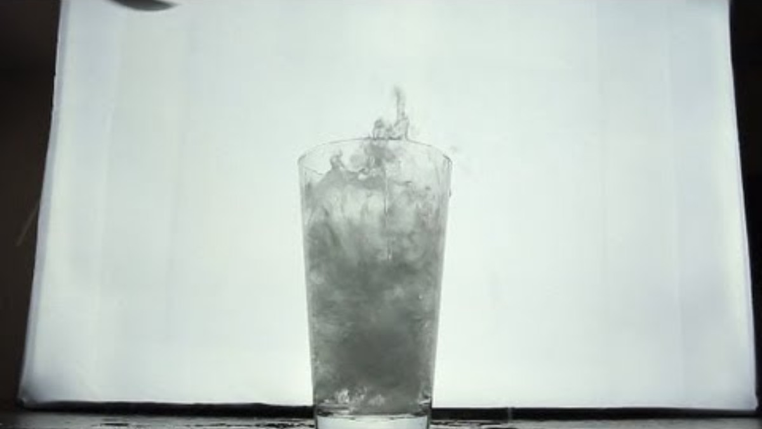
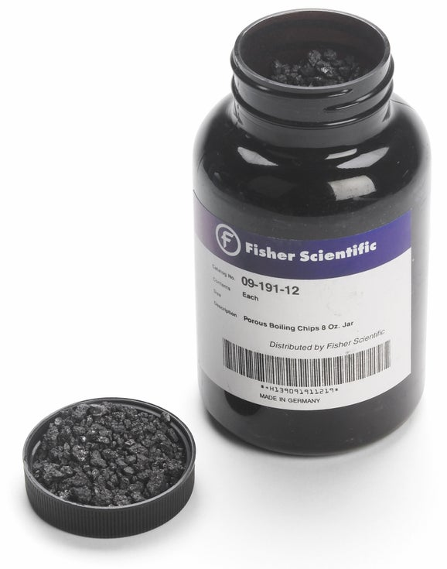
Superheating
Superheating is when a
liquid is brought to a
temperature above its
boiling point and the liquid is not boiling usually because it is in a clean, smooth container that does not cause boiling
Boiling does not just require the temp > boiling point: it requires rough surfaces to
create the nucleation for having the
liquid turn into a gas
Boiling chips are used in the chem
lab to ensure boiling happens when
temp reaches boiling point

Slide 46
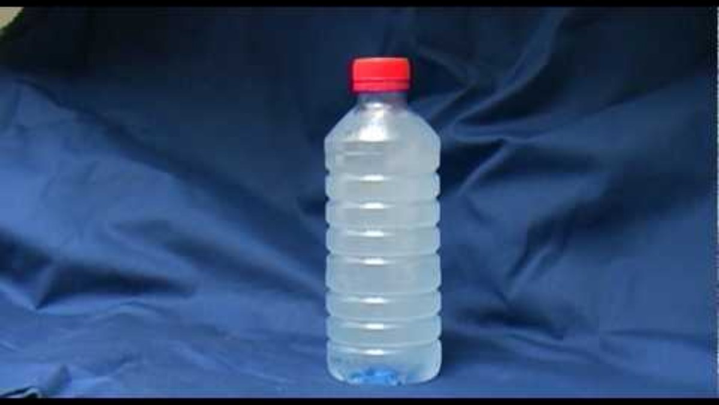
Supercooling
Supercooling occurs
when a liquid is at a
temperature below its
freezing point without
it showing its frozen solid
state
Just like superheating requires a rough surface (introducing impurity) or shock to induce the state change, so does supercooling.
“Freezing rain”: as rain fall from a freezing sky, it can retain its liquid (water) state, but when the rain strike a solid surface (power line, road), it can instantly turn to ice, creating a dangerous glaze

